Slide 1

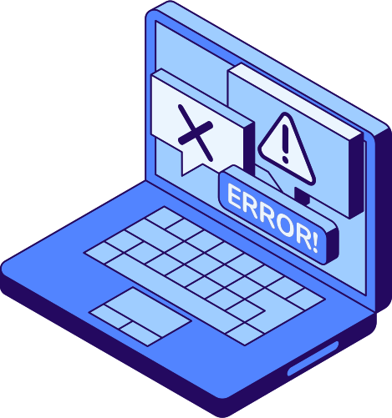
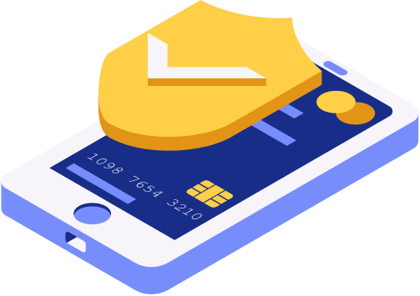

DON’T TAKE THE
BAIT: SPOT AND STOP PHISHING ATTACKS
By: Daniel Ayomide Rufus

Slide 2
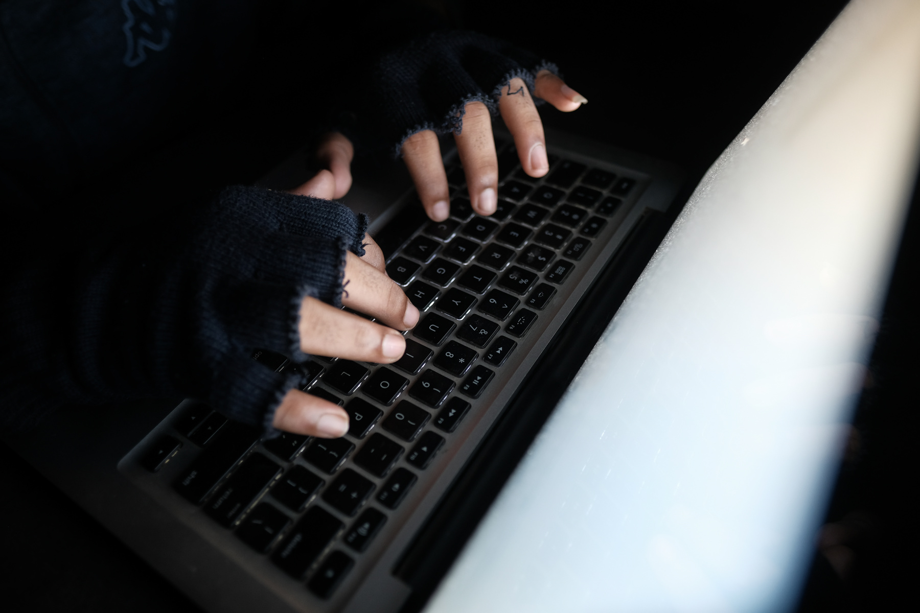
INTRODUCTION TO PHISHING
Phishing is a cyberattack where attackers impersonate trusted entities to steal sensitive data (passwords, credit cards) or install malware.

Slide 3

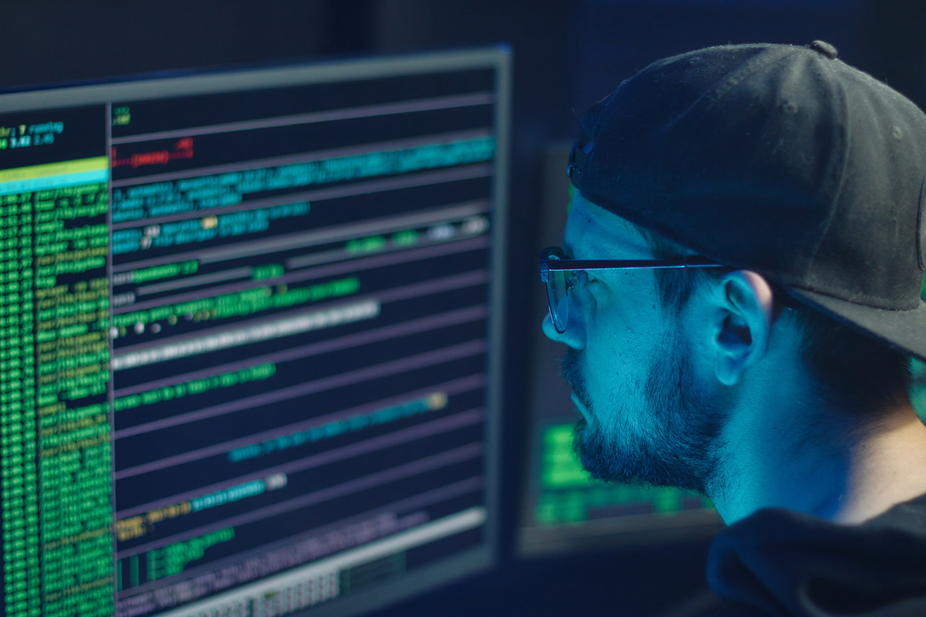

CYBER
IMPACT:
Financial losses (e.g., Business Email Compromise scams cost $2.7B in 2022).
Data breaches (e.g., Employee credentials leaked).

Slide 4
LETS TALK ABOUT A REAL LIFE SENAIRO OF WHATS HAPPENING IN OUR DAY LIFE
SUSPECTED RUSSIAN SPIES USED SOFTWARE UPDATE TO INFILTRATE U.S. GOVERNMENT.
It all began with something incredibly ordinary: a software update. Across the United States, in government offices and top companies, IT administrators like David were doing their jobs. They saw a notification for a routine update to their network management software, SolarWinds Orion. It was a trusted tool used to keep their digital infrastructure running smoothly. Confident in the software's security, David approved the update, just as thousands of others did.
But this was no ordinary update. Hidden deep within the code was a malicious backdoor, a secret entrance planted by a team of highly skilled, state-sponsored hackers. For months, this backdoor lay dormant. Then, silently, the hackers began to explore.
They moved like ghosts through the networks of the most secure organizations in the world—the U.S. Treasury, the Department of Commerce, and major tech companies. They didn't smash doors; they used the keys they had stolen. They read emails, copied files, and watched everything, all while remaining completely undetected. They were looking for secrets, and they found them.
The alarm was finally raised in December 2020, not by a government agency, but by a private cybersecurity firm, FireEye, which realized its own systems had been breached. As investigators dug deeper, the sheer scale of the attack became horrifyingly clear. The routine update had been a Trojan horse, turning a trusted tool into a weapon against its users.
The SolarWinds hack wasn't a quick smash-and-grab. It was a patient, sophisticated espionage campaign that compromised the digital backbone of a nation, proving that in the modern world, the most devastating invasions can happen with a single click.

Slide 5

A. Phishing Emails
Red Flags:
Generic greetings ("Dear User").
Urgent threats ("Your account will be deleted!").
Mismatched sender addresses (e.g., support@amaz0n.com).
Suspicious attachments or links (hover to preview URL).
Example: Include a screenshot of a fake PayPal email with annotations.
B. Fake Websites
Clues:
misspelled URLs (paypa1.com instead of paypal.com).
No padlock icon (HTTP vs. HTTPS).
Poor design/grammar.
HOW TO RECOGNIZE
PHISHING

Slide 6
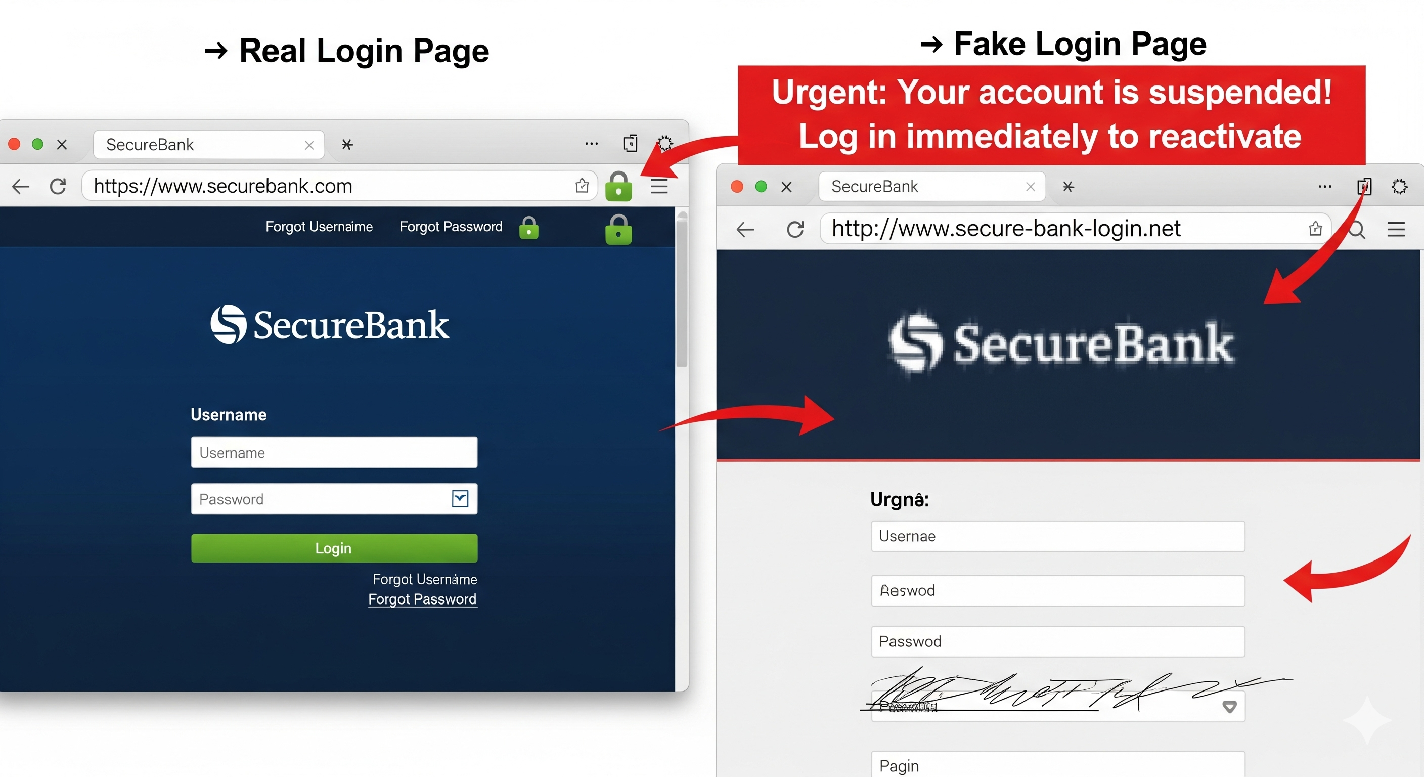
PICTORIAL EXPLANATION OF FAKE LOGIN PAGE AND REAL LOGIN PAGE

Slide 7
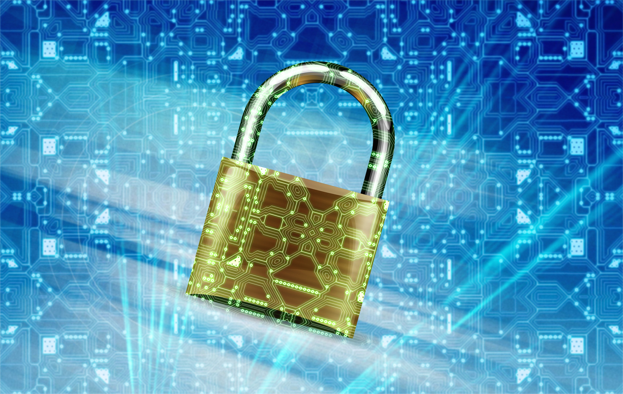
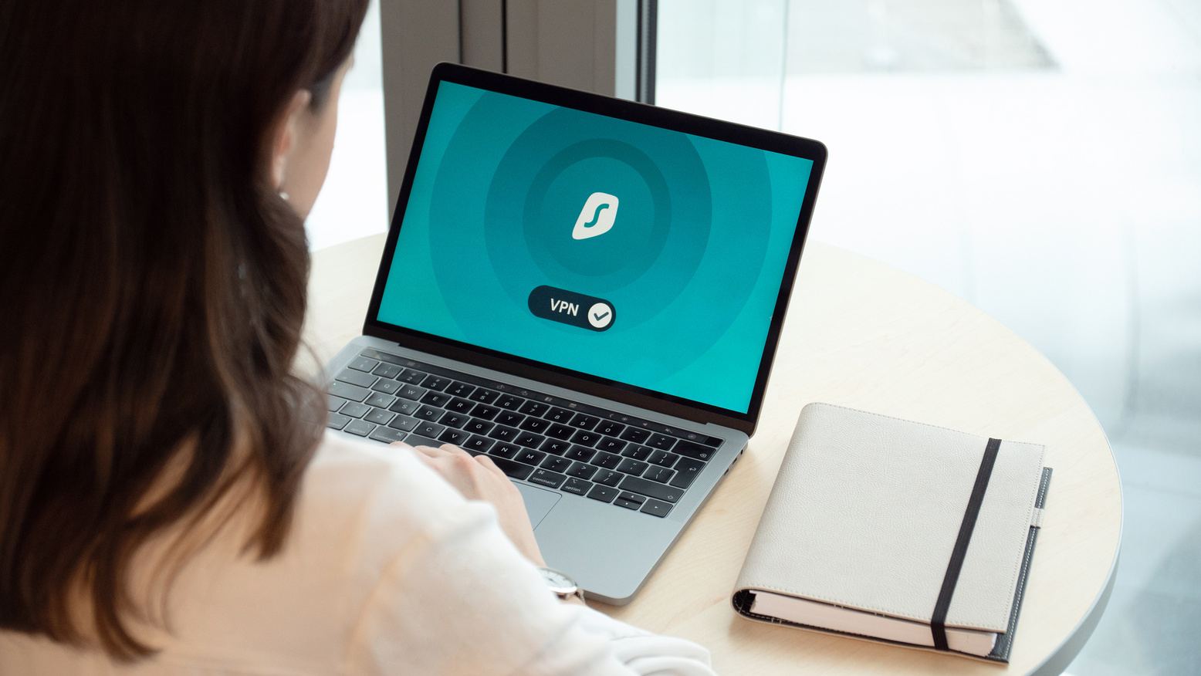
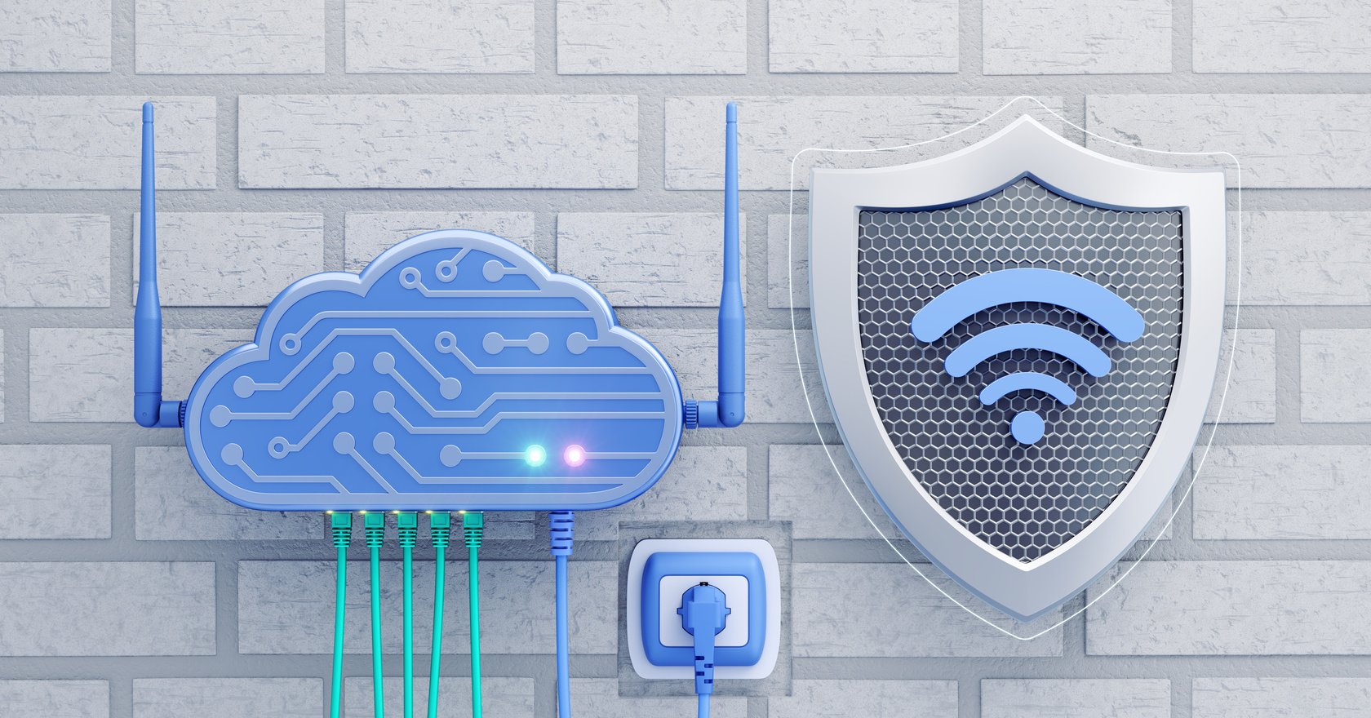
SOCIAL ENGINEERING
TACTICS
Psychological Triggers:
Fear ("Your account is compromised! Click now!").
Authority ("IT Dept requests your password immediately").
Scarcity ("Limited-time offer!").
Case Study: Detect Scam by Rufus
Scenario: Attackers impersonated Rufus’s customer support, sending emails claiming "unusual login activity" and directing users to a fake login page.
Outcome: Several users entered their credentials, leading to account takeovers.
Lesson: Always verify the sender’s email and avoid clicking links in unsolicited emails.

Slide 8
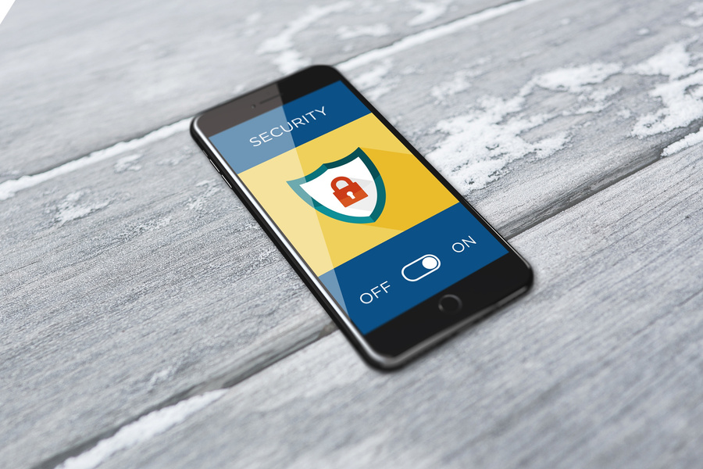

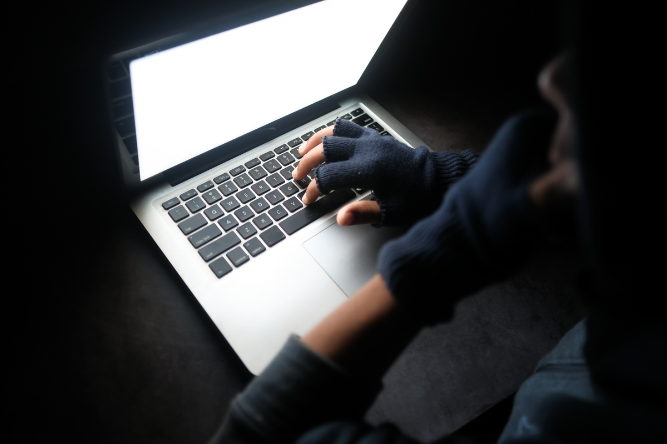

BEST
PRACTICES TO STAY SAFE
Strong Passwords
Regular Backups
Maintain frequent backups of critical data, following the 3-2-1 rule (3 copies, 2 local, 1 offsite), to recover quickly from ransomware or data loss.
Use passwords with at least 12 characters, including a mix of letters, numbers, and symbols, to make them harder to crack.
Employee Training
Access Control
Conduct regular cybersecurity training and phishing simulations to help employees recognize and avoid social engineering attacks.
Implement the principle of least privilege, ensuring employees only have access to the systems and data necessary for their roles.

Slide 9
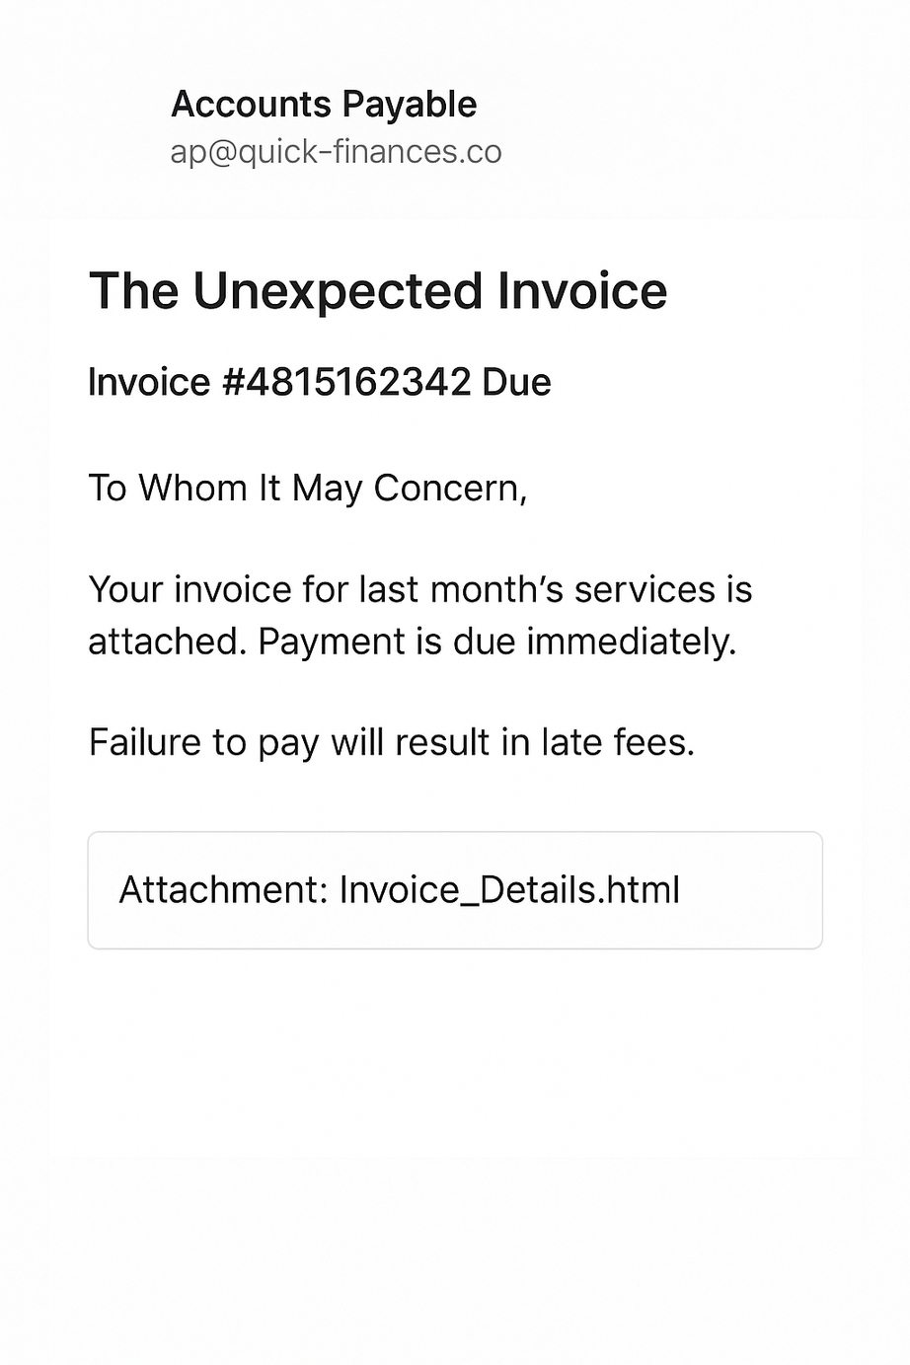
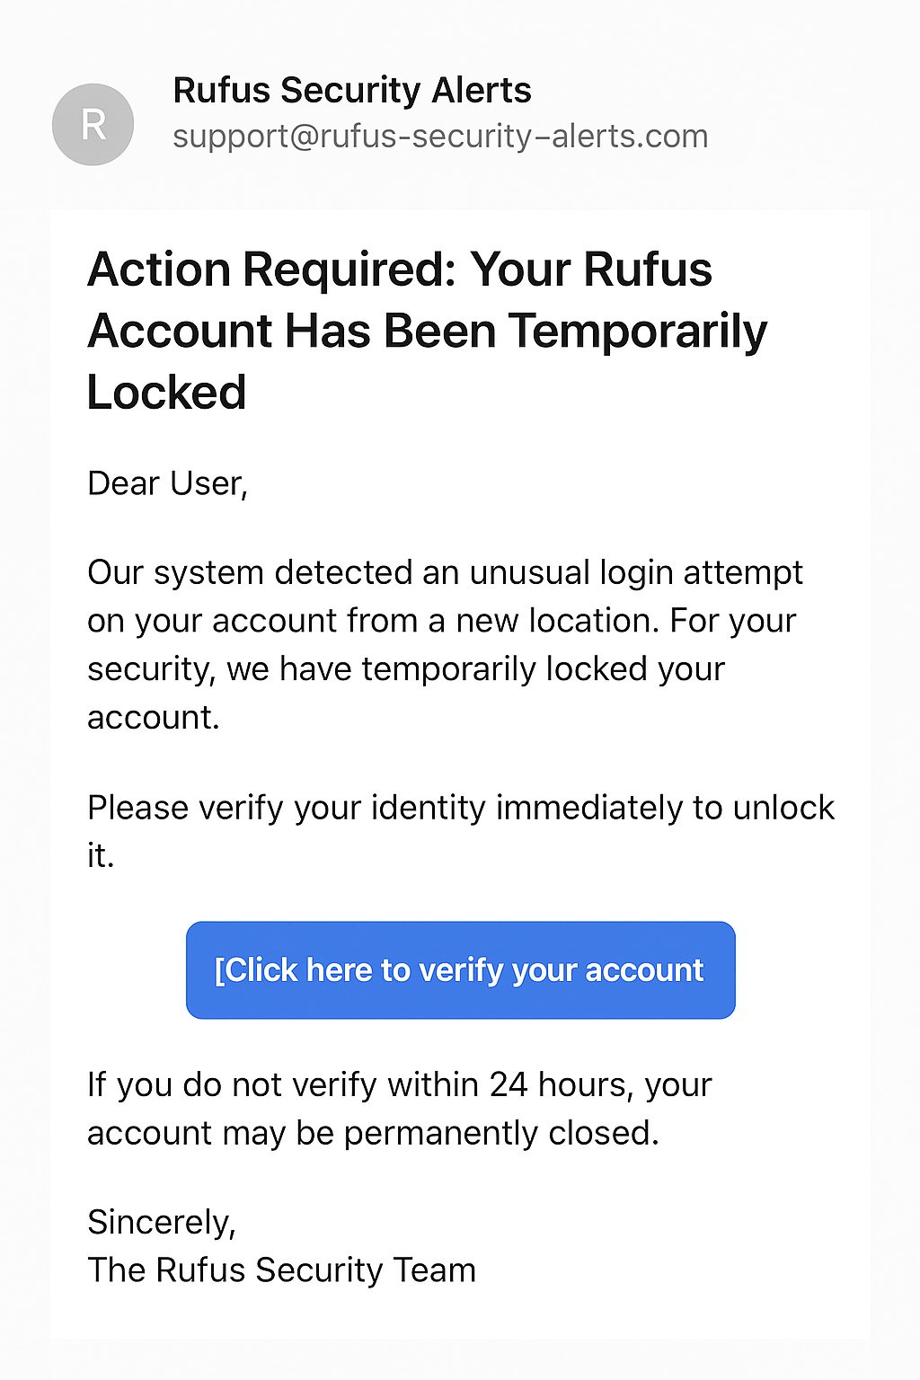
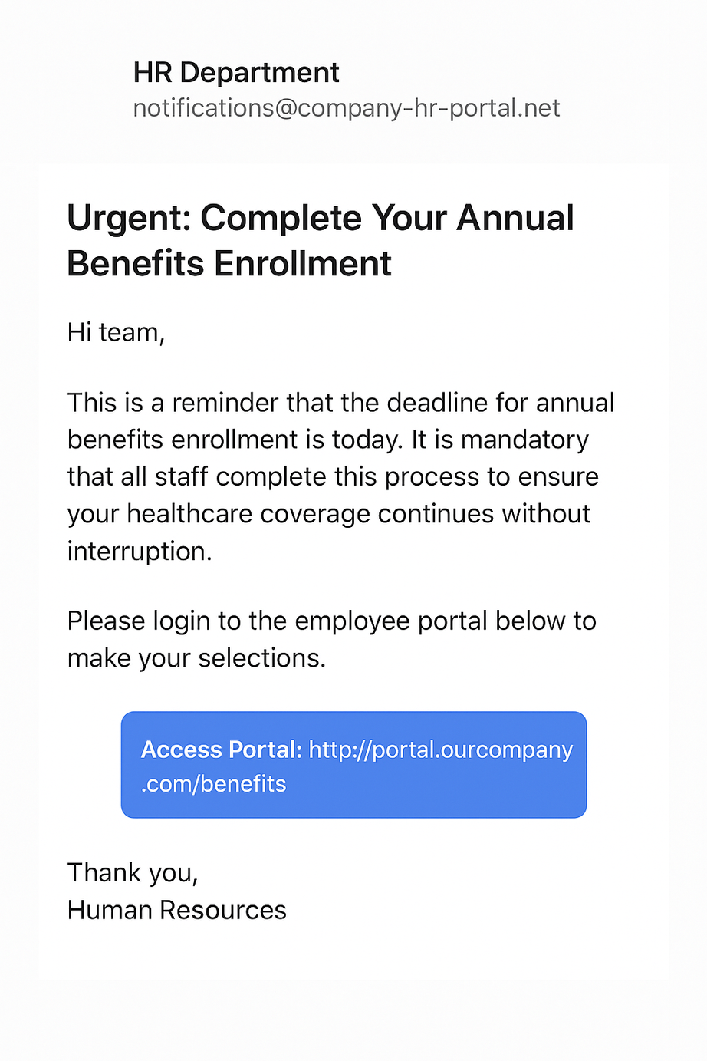
Interactive Engagement
SPOT THE SCAM
QUIZ:

Slide 10
REAL-WORLD PHISHING EXAMPLES EXPLAINED
01
02
CEO Fraud (Business Email Compromise - BEC)
HTTPS Phishing (The "Secure" Scam)
How It Works:
Attackers impersonate CEOs, CFOs, or executives via email (e.g., "Urgent: Wire $50K to Vendor X Today!").
They spoof the executive’s email (e.g., ceo@yourcompany.com → ceo@yourcompanyy.com) or hack their account.
Pressure tactics: Claims like "Confidential—don’t discuss this with anyone!" to bypass checks.
Why It’s Dangerous:
No malware needed—just psychology.
Targets finance/HR teams who regularly handle payments.
$2.7B lost annually (FBI 2023 report).
How to Stop It:
Verification: Require two-person approval for wire transfers.
Training: Teach staff to call/verify unusual requests (even if marked "urgent").
How It Works:
Scammers create fake banking/login pages with HTTPS padlocks (e.g., https://paypa1-login.com).
Victims trust the padlock, thinking it’s legitimate.
Example: A cloned Microsoft 365 login page steals credentials.
Why It’s Dangerous:
87% of phishing sites now use HTTPS (Anti-Phishing Working Group, 2024).
Even tech-savvy users assume HTTPS = safe.
How to Spot It:
Check the domain closely (e.g., apple.com vs. apple-id.com).
Never enter credentials unless you initiated the login.

